Slide 1



McDonald's: Adapting to Local Cultures
McDonald's, a global fast food giant, has a long history of expanding its operations across the world. As the company grew, they quickly realized the importance of adapting to local cultures to ensure success.
By Sai Surya

Slide 2


Early International Expansion
1
1967
McDonald's opened its first international restaurant in Canada.
2
1971
The company expanded into Japan, marking a major step towards global domination.
3
1975
McDonald's continued its global expansion by opening its first restaurant in Europe in the Netherlands.
4
1980s
McDonald's rapidly expanded into new markets across Asia, South America, and Africa.

Slide 3
Challenges of Adaptation
Dietary Preferences
Religious Beliefs
Social Norms
Different cultures have diverse dietary preferences, and McDonald's had to adapt its menu accordingly.
McDonald's had to consider religious beliefs and dietary restrictions when developing its menus, especially in regions with a significant Muslim population.
McDonald's needed to adjust its marketing strategies and restaurant designs to align with local social norms.

Slide 4


Menu Localization
1
McSpicy Paneer Wrap (India)
2
McArabia (Middle East)
This flavorful wrap combines spicy paneer cheese with fresh vegetables and a tangy sauce, catering to the Indian taste for spice and vegetarian options.
This popular sandwich features grilled chicken or beef, hummus, and vegetables, offering a taste of Middle Eastern flavors.
4
Chicken McDo (Philippines)
3
McVeggie (India)
This signature Filipino item features a crispy fried chicken patty, offering a local twist on the classic McDonald's menu.
McDonald's introduced this vegetarian burger to cater to the large vegetarian population in India, combining a flavorful patty with fresh vegetables and a tangy sauce.

Slide 5
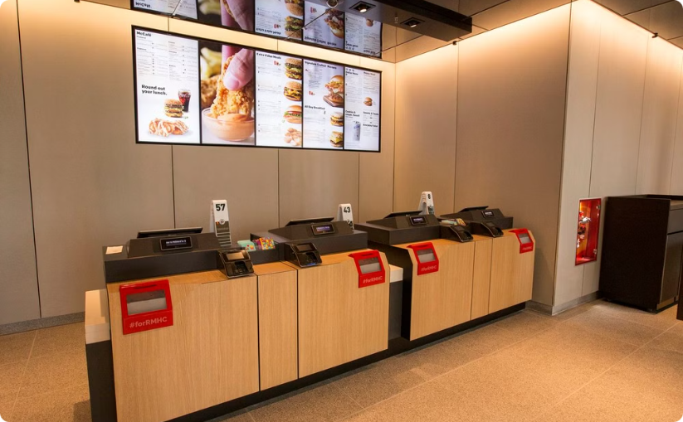

Architectural and Design Adaptations
Modern Architecture
Traditional Design
McDonald's has adopted a more modern, minimalist design for its restaurants in developed countries, creating a clean and inviting ambiance.
In some countries, McDonald's has incorporated traditional architectural elements to blend in with the local landscape.

Slide 6





Operational Adjustments
Hiring Practices
McDonald's has adapted its hiring practices to local employment laws and cultural norms.
Employee Training
McDonald's provides training programs that are tailored to the specific needs and cultural sensitivities of each market.
Customer Service
McDonald's emphasizes customer service training that aligns with local expectations for politeness and hospitality.

Slide 7


Marketing and Branding
Local Languages
McDonald's has translated its marketing materials into local languages to ensure effective communication with customers.
McDonald's leverages local celebrities and influencers in its marketing campaigns to connect with the target audience.
Celebrity Endorsements
Cultural Themes
McDonald's incorporates cultural themes and imagery into its advertising and promotions to resonate with local values.

Slide 8





Partnerships with Local Suppliers
Local Ingredients
McDonald's sources ingredients from local suppliers to support the local economy and ensure the quality of its products.
Production Facilities
McDonald's has established partnerships with local food processors and manufacturers to produce products tailored to local preferences.
Distribution Networks
McDonald's works with local distributors to ensure the efficient delivery of its products to restaurants across the country.

Slide 9

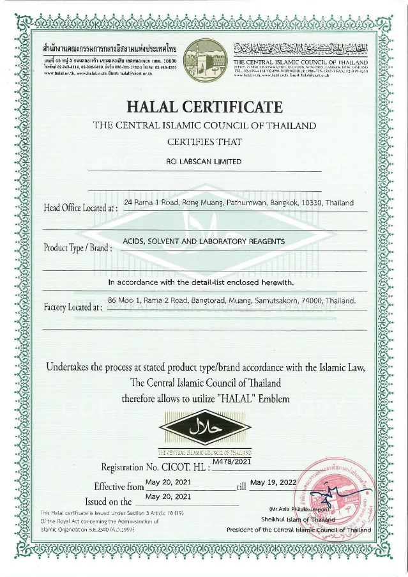
Cultural Sensitivities and Dietary Restrictions
Halal Certification
Vegetarian Options
In Muslim-majority countries, McDonald's ensures that its meat products are Halal-certified, meeting Islamic dietary guidelines.
McDonald's offers a variety of vegetarian options in countries with a large vegetarian population, such as India and several parts of Asia.
Local Ingredients
McDonald's has developed menu items that utilize local ingredients and flavors, catering to the specific tastes of each region.

Slide 10


Lessons Learned and the Importance of Adaptation
McDonald's success in adapting to local cultures has been instrumental in its global dominance. The company has learned the importance of understanding and respecting cultural differences to build successful businesses around the world. Through its commitment to localization, McDonald's has become a symbol of globalization and cultural exchange.

